Slide 1
QUIC

Slide 2
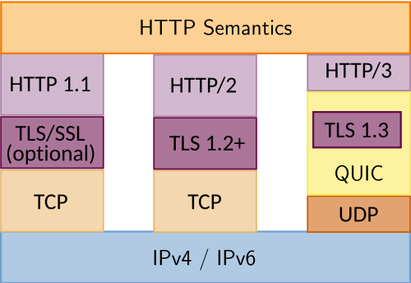
QUIC - Why
QUIC - Quick UDP Internet Connections
The reasons:
The evolution of HTTP protocol - TCP became a bottleneck
The inefficiency of having 2 handshakes (TCP + TLS) in order to establish a connection
Middlebox headache
TCP rigidity
UDP flexibility

Slide 3
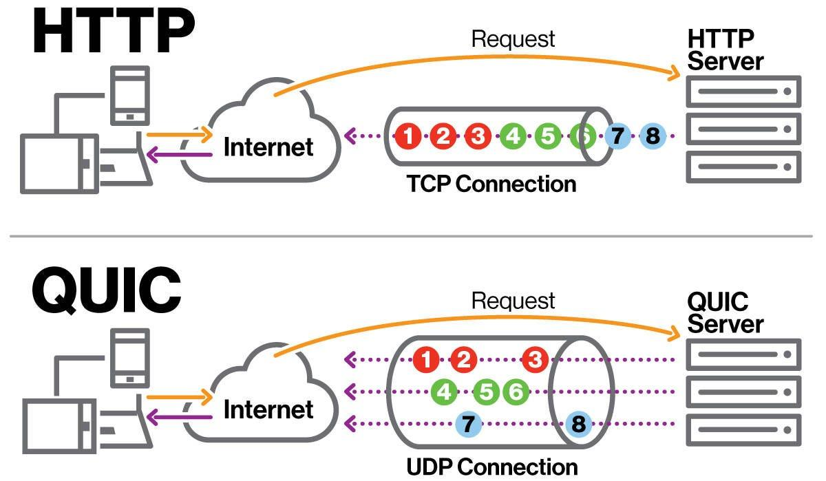
QUIC - Why
HTTP protocol evolution
HTTP 1.0
Single request per TCP connection
HTTP 1.1
TCP connection with single stream
HTTP 2.0
TCP connection with multiple streams
QUIC/HTTP 3.0
UDP connections with multiple streams

Slide 4
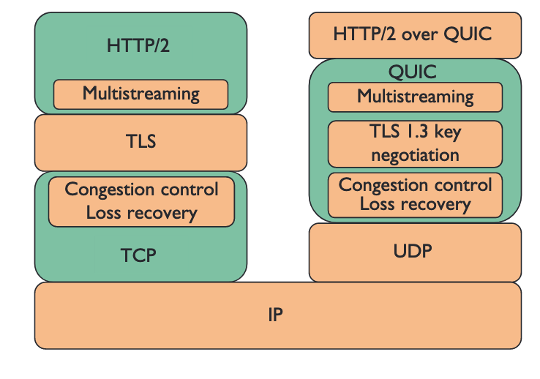
QUIC - How
Key features:
0-RTT/1-RTT Connection establishment - it combines the transport and the cryptographic handshakes into one
Real multiplexing - one lost packet in one stream will not block the other streams as in TCP/TLS/HTTP2.0. Instead it provides multiple, independent and reliable streams
Connection migration - connections are identified by a unique 64-bit Connection ID rather than the IP address
Flexibility of congestion control and loss recovery algorithms over the TCP rigid kernel implementations
Greasing concept - future protocol development

Slide 5
QUIC - How
The encoding used by QUIC is UDP Datagram -> QUIC Packet -> One or more Frames
Packets are splitted in 2 categories:
Long header packets used during the setup phase: Ex. Initial Packet, Handshake Packet, 0-RTT Packet, Retry Packet
Short header packets used after the handshake is done for data transfer
A packet contain one or more Frames:
CRYPTO Frame - carries TLS messages
STREAM Frame - carries application data
ACK Frame - acknowledges received packets
PING Frame - keeps the connection alive
Other control frames - RESET_STREAM, STOP_SENDING, CONNECTION_CLOSE, PATH_CHALLENGE etc.

Slide 6
MITM

Slide 7
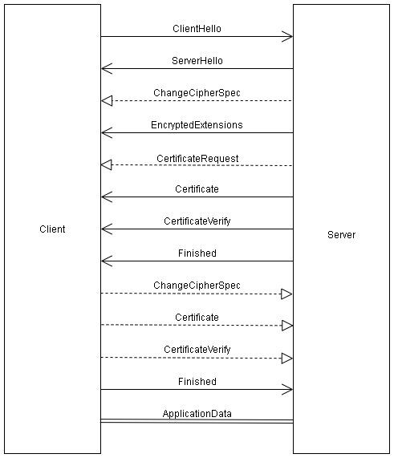
MITM - What and why
MITM - Man in the Middle attack
An attacker intercepts a connection between a client and a server with the purpose of observing or modifying the communication
It gets in the middle acting as a server for the client and as a client for the real server and forwarding the traffic between the client and the real server as it is or modified
TLS uses certificates as a protection mechanism for this attack so it is pretty hard to do that to a TLS connection outside of a controlled environment

Slide 8
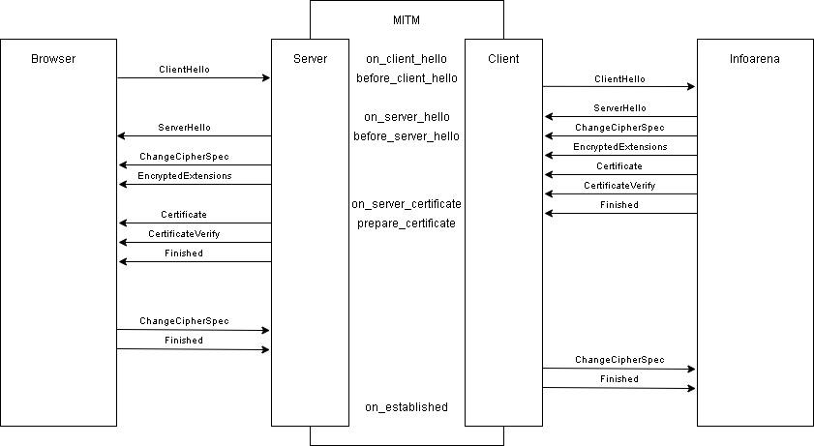

Slide 9
References
https://datatracker.ietf.org/doc/html/rfc9000
https://developer.mozilla.org/en-US/docs/Web/HTTP/Guides/Evolution_of_HTTP
https://www.youtube.com/watch?v=dQ5AND4DPyU

